Slide 1

ASP.NET MVC
Rajeev D L

Slide 2
Agenda
MVC Introduction
Release History
Getting Started
MVC Application Life Cycle
Razor View Engine
Controllers
Routing, Attribute Routing
HTML Helpers, Strongly Types Views
Custom HTML Helpers
Partial Views, Layouts, Sections
Model Validation
JavaScript and Ajax
Bootstrap
Dependency Injection using NInject
Bundling & Minification
GZip Compression
Caching
CSRF
Web API
CORS
Authentication
Filters
Best Practices
What is new in MVC 6

Slide 3
MVC Programming Model
Model
Design pattern
Framework for building applications using a MVC (Model View Controller) design.
Separation of concerns
Model: Represents the application core (for instance a list of database records).
View: Displays the data (the database records).
Controller: Handles the input (to the database records).
View
Controller
The Model is the part of the application that handles the logic for the application data. Often model objects retrieve data (and store data) from a database.
The View is the parts of the application that handles the display of the data. Most often the views are created from the model data.
The Controller is the part of the application that handles user interaction.

Slide 4
ASP.NET MVC
Alternative to the ASP.NET Web Forms for creating Web applications
Lightweight, highly testable presentation framework that is integrated with existing ASP.NET features (Master Pages, Security, and Authentication)
Used for developing websites using JavaScript's, HTML, CSS, .NET language
Not a replacement for ASP.NET Web Forms
Option for developing websites with MVC design pattern
Assembly: System.Web.Mvc
Open Source
Web Sites
Web Services
ASP.NET MVC
ASP.NET Web Forms
ASP.NET Web Pages
Web API
SignalR
ASP.NET Framework
.NET Framework

Slide 5
Why MVC
Advantages of Web Forms
ViewState
Rapid Application Development
Controls and Toolbox
Maturity
Code Generation
Familiarity

Slide 6
Why MVC?
Separation of application tasks - The MVC Paradigm of Model-View-Controller allows you to more easily separate all of your concerns within your application. This can lead to improved scalability within applications.
Testing - MVC is designed and built for Testing-Driven Development and allows for applications to be very easily tested to help secure against error and unexpected behavior
Integration with Client-Side Tools - The MVC pattern easily allows client-side tools such as jQuery to be seamlessly integrated. This can allow you to create very rich user interfaces for your applications.
Statelessness - Although one of the main advantages of Web Forms, this allows you to adhere to a more stateless format consistent with the rest of the web
Control and Flexibility - MVC allows developers to have complete control over their applications as the developer doesn't rely on Controls to automatically generate the appropriate HTML, which after switching to MVC can often be seen as "bloated". The developer will write their own HTML instead of having it generated for them.
Search Engine Optimization - The use of RESTful URLs within MVC makes it more friendly for being accessed through search engines.
Extensive support for ASP.NET routing

Slide 7
Release History
Date | Version | New Features
10 Dec 07 | ASP.NET MVC CTP
13 Mar 09 | ASP.NET MVC 1.0
10 Mar 10 | ASP.NET MVC 2
13 Jan 11 | ASP.NET MVC 3
15 Aug 12 | ASP.NET MVC 4 | ASP.NET Web API, Mobile Project Template, Task Support for Asynchronous Controllers, Azure SDK, Entity Framework 5, Bundling and Minification, Oauth
17 Oct 2013 | ASP.NET MVC 5 | ASP.NET Identity, Bootstrap, Authentication filters, Filter overrides, Attribute routing, ASP.NET Scaffolding
17 Jan 2014 | ASP.NET MVC 5.1
01 Jul 2014 | ASP.NET MVC 5.2.0
09 Feb 2015 | ASP.NET MVC 5.2.3
 | ASP.NET MVC 6.0

Slide 8

ASP.NET MVC Pipeline
ASP.NET MVC
HTTP Request
Routing
Engine
Lookup
User
Controller
Model
HTTP Response
View
Lookup
View Engine
Notes:
For MVC Life Cycle Refer: http://www.asp.net/mvc/overview/getting-started/lifecycle-of-an-aspnet-mvc-5-application

Slide 9
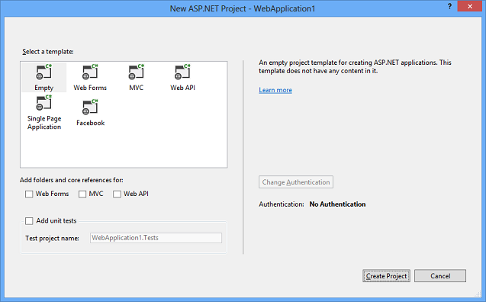
Getting Started – Project Templates 2013
Empty Template - Provides the bare minimum folders and files for an ASP.NET web site, such as a project file (.csproj or .vbproj) and a Web.config file. No authentication options are available.
Web Forms Template – Mainly for Web Forms Application
MVC Template – For MVC Applications
Web API Template - Creates a sample web service based on Web API.
Single Page Application Template - Creates a sample application that uses JavaScript, HTML 5, and KnockoutJS on the client, and ASP.NET Web API on the server. The only authentication option for the SPA template is Individual User Accounts.
Facebook Template - Creates a sample application that is designed to run inside the Facebook web site. It is based on ASP.NET MVC and uses Web API for real-time update functionality.
No authentication options are available for the Facebook template because Facebook applications run within the Facebook site and rely on Facebook's authentication.

Slide 10

Project Template – Additional References
Add Web Forms Support - Creates empty App_Data and Models folders and a Global.asax file. These are already created by all templates other than the Empty template.
Add MVC Support - Installs MVC, Razor, and WebPages NuGet packages, creates empty App_Data, Controllers, Models, and Views folders, creates App_Start folder with RouteConfig.cs file, and creates Global.asax file.
Add Web API Support - Installs WebApi and Newtonsoft.Json NuGet packages, creates empty App_Data, Controllers, and Models folders, creates App_Start folder with WebApiConfig.cs file, and creates Global.asax file.

Slide 11
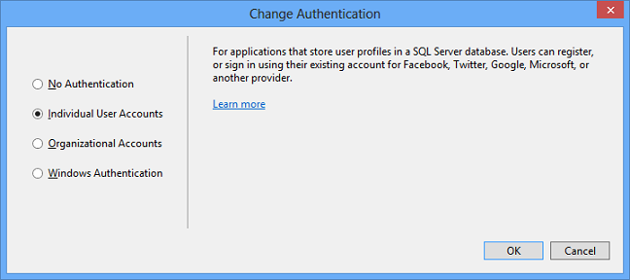
Project Template – Authentication
No Authentication - The sample application will contain no web pages for logging in, no UI indicating who is logged in, no entity classes for a membership database, and no connection string for a membership database.
Individual User Accounts - The sample application will be configured to use ASP.NET Identity (formerly known as ASP.NET membership) for user authentication. ASP.NET Identity enables a user to register an account, by creating a username and password on the site or by signing in with social providers such as Facebook, Google, Microsoft Account, or Twitter. The default data store for user profiles in ASP.NET Identity is a SQL Server LocalDB database.

Slide 12
Project Template – Authentication Cont…
Organizational Accounts - The sample application will be configured to use Windows Identity Foundation (WIF) for authentication based on user accounts in Windows Server Active Directory.
Windows Authentication - The sample application will be configured to use the Windows Authentication IIS module for authentication. The application will display the domain and user ID of the Active directory or local machine account that is logged into Windows but won't include user registration or log-in UI. This option is intended for Intranet web sites.
You can create an Intranet site that uses AD authentication by choosing the On-Premises option under Organizational Accounts. The On-Premises option uses Windows Identity Foundation (WIF) instead of the Windows Authentication module. Some additional steps are required in order to set up the On-Premises option, but WIF enables features that aren't available with the Windows Authentication module. For example, with WIF you can configure application access in Active Directory and query directory data.

Slide 13
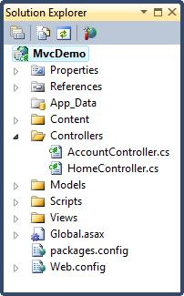
MVC Project Structure
Basic structure of a MVC Project
Controller
Model
View

Slide 14
The Model Layer
The Model contains business logic of the application.
Model objects implement the logic for application’s data domain.
Just a class
File Extension: .cs (c#) and .vb(vb)
Example
public class Auction
{
public long Id { get; set; }
public string Title { get; set; }
public string Description { get; set; }
public string ImageUrl { get; set; }
public DateTime StartTime { get; set; }
public DateTime EndTime { get; set; }
public decimal StartPrice { get; set; }
public decimal CurrentPrice { get; set; }
}

Slide 15
The View Layer
Responsible for interacting with the user
Helps to Visualize the model and communicate with the user
Content Type : HTML/JavaScript/CSS
Can also render JSON, XML, Custom return types.
File Type: HTML/JavaScript file, .cshtml(c#), .vbhtml (vb) (Razor)
@{
ViewBag.Title = "Home Page";
}
<h2>My Index Page</h2>

Slide 16
View Engine
Responsible for rendering the HTML from your views to the browser
Different syntax for implementation
Razor, traditional ASPX, Spark, Nhaml, Ndjango, Hasic, Brail, Bellevue, SharpTiles, String Template, Wing Beats, SharpDOM
Can use multiple view engines in parallel
Razor view engine
Advanced view engine from Microsoft, packaged with MVC 3
Syntax: @ character instead of aspx's <% %>
Razor does not require you to explicitly close the code-block
File extension cshtml (C#) or vbhtml (VB).
Accepted as the best view engine for MVC

Slide 17
The Controller Layer
Controls the application flow and interaction between the Model and View
Brains of the ASP.NET MVC application
Request the data from the Model Layer
Controller does not perform any of the work directly
It delegates the work to models and the view layer to do real work
File Type: Class file. (.cs extension)
Example: (http://localhost:59581/Auctions/Index)
public class AuctionsController : Controller
{
// GET: /Auctions/
public ActionResult Index()
{
return View();
}
}

Slide 18
Controller – Cont..
The base class for all Controller is ControllerBase
Controller class inherits from ControllerBase
public class HomeController : Controller
Action Methods
The controller defines action methods
Controllers can include as many action methods as needed
Action Result
Most action methods return an instance of a class that derives from ActionResult
ActionResult class is the base for all action results

Slide 19
Controller – Action Result
Action Result | Helper Method | Description
ViewResult | View | Renders a view as a Web page.
PartialViewResult | PartialView | Renders a partial view, which defines a section of a view that can be rendered inside another view
JsonResult | Json | Returns a serialized JSON object.
JavaScriptResult | JavaScript | Returns a script that can be executed on the client.
FileResult | File | Returns binary output to write to the response.
ContentResult | Content | Returns a user-defined content type.
RedirectResult | Redirect | Redirects to another action method by using its URL.

Slide 20
Controller – Cont..
Non Action Methods
By default, MVC treats all public methods of a controller class as action methods
If your controller class contains a public method and you do not want it to be an action method, you must mark that method with the NonActionAttribute attribute
[NonAction]
private void DoSomething() { // Method logic. }
Parameters
ASP.NET MVC can automatically map URL parameter values to parameter values for action methods.
Also support Optional Parameters
public ResultAction Detail(int id)
{ return View(); }
public ActionResult ShowArticles(DateTime? date) {

Slide 21
AcceptVerbs
Enables you to prevent an action from being invoked unless a particular HTTP operation is performed
GET - Read
POST - Create
PUT - Update
DELETE - Remove
OPTIONS :- Returns information about the communication options available.
HEAD :- Same as GET without returning the message body.
TRACE :- Performs a message loop back.
CONNECT:-SSL tunneling.

Slide 22
ActionName - Attribute
Help you to expose an action with a different name than its method name
You can use this attribute in two different situation
In case of Overloaded methods, you can use the ActionName attribute to expose two methods with the same name as actions with different names.
Different names of the method in the controller and want to expose these methods as actions with the same name.

Slide 23
Unknown Actions
HandleUnknownAction()
Automatically when a controller cannot find an action
By default this method throws a 404 resource Not Found HTTP exception.
But you can override this method in your controller class with your own custom logic or error message that you want to show.
protected override void HandleUnknownAction(string actionName)
{
...
}

Slide 24
Asynchronous Controllers
Enables to write asynchronous action methods
Allows you to perform long running operation(s) without making the running thread idle
Does not mean it will take lesser time to complete the action
But the server is not blocked from responding to the other requests
Instead of deriving the controller from Controller, derive it from AsyncController.
Controllers that derive from AsyncController enable ASP.NET to process asynchronous requests
public class AsynchronuosTestingController : AsyncController {

Slide 25
Asynchronous Controllers
When an asynchronous action is invoked, the following steps occur:
The Web server gets a thread from the thread pool (the worker thread) and schedules it to handle an incoming request. This worker thread initiates an asynchronous operation.
The worker thread is returned to the thread pool to service another Web request.
When the asynchronous operation is complete, it notifies ASP.NET.
The Web server gets a worker thread from the thread pool (which might be a different thread from the thread that started the asynchronous operation) to process the remainder of the request, including rendering the response.

Slide 26
Async Controller in MVC 3.0
Use AsyncController
You have to create two methods
One to start the async operation
Another to end it
public class DoController : AsyncController
{
public void StuffAsync()
{
// Action Method
}
public ActionResult StuffCompleted(string text)
{
return View(model);
}
}

Slide 27
Async Controller in MVC 4.5
Using async/await keywords
public class DoController : AsyncController
{
public async Task<ViewResult> Stuff()
{
return View(new DoStuffViewModel()
{
Text = await DoStuff("Some other stuff")
});
}
private async Task<string> DoStuff(string input)
{
Thread.Sleep(5000); return input;
}
}

Slide 28
Routing
Inspect the incoming URL
Determine which controller action it corresponds to
Then pass the execution to that controller action
YES
Process the Route
Request URL
Route Found
Parse URL
Locate Matching Route
Routing Engine
Not found 404!
NO

Slide 29
Routing – Cont..
In Global.asax.cs
protected void Application_Start()
{
...
RouteConfig.RegisterRoutes(RouteTable.Routes);
...
}
In App_start\RouteConfig.cs
public static void RegisterRoutes(RouteCollection routes)
{
routes.IgnoreRoute("{resource}.axd/{*pathInfo}");
routes.MapRoute(
name: "Default",
url: "{controller}/{action}/{id}",
defaults: new {controller = "Home", action = "Index", id = UrlParameter.Optional} );
}
Problem with the Convention-based Routing
1. routes are physically separated from the controllers
2. Need some detective work to understand the relationships

Slide 30
Attribute Routing
Latest feature offered by MVC5
Attribute Routing uses the same mechanism of Routing Framework
Uses Attributes to define routes
Can be used on controller actions and even controller classes
How to Enable?
public class RouteConfig {
public static void RegisterRoutes(RouteCollection routes) {
routes.IgnoreRoute("{resource}.axd/{*pathInfo}");
//Add the following line of code
routes.MapMvcAttributeRoutes();
}
}
Can keep both the “Convention-based Routing” as well as the “Attribute Routing” under the application. But
MapMvcAttributeRoutes() have to call before the Convention-based Routing

Slide 31
Attribute Routing – Cont..
Defining a Route - A route attribute has to be defined on top of an action method or on the top of a controller.
[Route("Users/about")]
public ActionResult About()
Defining a Common Prefix - To specify a common prefix for an entire controller, then use [RoutePrefix] at the controller level.
[RoutePrefix("Movie")]
public class HomeController : Controller

Slide 32
Attribute Routing – Cont..
Overriding Route Prefix
To override a common route prefix, use tilde(~) on the Route attribute over the action method
[RoutePrefix("Movie")]
public class HomeController : Controller
{
//Route: Movie/Index
[Route]
public ActionResult Index() {return View(); }
//Route: /About
[Route("~/About")]
public ActionResult About() { return View(); }
}

Slide 33
Attribute Routing – Cont..
Defining a Default Route - First apply the [Route] attribute on the Controller level and then specify a default action as a parameter.
[RoutePrefix("Movie")]
[Route("{action=index}")]
public class HomeController : Controller {
public ActionResult Index() {
Optional URI Parameter - Add a question mark to the Route parameter
[Route("home/{id?}")]
public ActionResult Employee(int id) {
Default Value in URI Parameter - To specify any parameter as default, initialize a value in the route parameter
[Route("home/{type=en}")]
public ActionResult Search(string type) {

Slide 34
HTML Helpers
Simple functions that let the developer to specify the type of HTML needed on the view
Final HTML will be generated by these functions at the runtime
Following HTML helpers are built into the ASP.NET MVC framework:
@Html.Editor(“txtName”)
<input class=“text-box single-line” id=“txtName” name=“txtName” type=“text” value=“” />
Html.BeginForm
Html.EndForm
Html.TextArea
Html.Password
Html.CheckBox
Html.TextBox
Html.Hidden
Html.ListBox
Html.RadioButton
Html.DropDownList

Slide 35
Strongly Typed Views
It has a ViewModel associated to it
Can bind any class as model to view.
Can access model properties on that view
@model IEnumerable<Employee.Models.Comment>
@foreach(var item in Model){
<p>@item.Name</p>
}
HTML Helpers for Strongly Typed Views
Html.TextBoxFor
Html.HiddenFor
Html.PasswordFor
Html.TextAreaFor
Html.RadioButtonFor
Html.DropDownListFor
Html.ListBoxFor
Html.CheckBoxFor

Slide 36
Rendering Links
Easiest way to render an HTML link in a view is to use the HTML.ActionLink() helper
The Html.ActionLink() does not link to a view
Instead, you use the Html.ActionLink() helper to create a link to a controller action
@Html.ActionLink("About this Website", "About" )
First parameter passed to the Html.ActionLink() represents the link text and the second parameter represents the name of the controller action
Output
<a href=”/Home/About”>About this Website</a>

Slide 37
Rendering Image Links
You can’t use the Html.ActionLink() helper to render an image link
Because the Html.ActionLink() helper HTML encodes its link text automatically, you cannot pass an <img> tag to this method and expect the tag to render as an image.
Instead, you need to use the Url.Action() helper to generate the proper link
<a href=”@Url.Action(“Delete”)”><img src=”../../Content/Delete.png” alt=”Delete” style=”border:0px” /></a>

Slide 38
Rendering Form
The BeginForm helper marks the start of an HTML form and renders as an HTML form element
The BeginForm helper implements the IDisposable interface, which enables you to use the using keyword
Example
@using (Html.BeginForm("Signup", "Account", FormMethod.Post, (new { @class = "form-horizontal" })))
{

Slide 39
Custom HTML Helpers – Using Static Method
Creating a static method - simply create a static class with static method which will return the HTML string to be used at the time of rendering
namespace HTMLHelpersDemo.Helpers {
public static class MyHTMLHelpers {
public static IHtmlString LabelWithMark(string content) {
string htmlString = String.Format("<label><mark>{0}</mark></label>", content); return new HtmlString(htmlString);
}
}
}
In View,
@using HTMLHelpersDemo.Helpers
..
@ MyHTMLHelpers LabelWithMark(“Static method HTML Helper”)

Slide 40
Custom HTML Helpers – Using Extension Method
Writing an extension method – can write a simple extension method for the built in html helper class. (Enables to add methods to existing class)
public static class MyExtensionMethods {
public static IHtmlString LabelWithMark(this HtmlHelper helper, string content) {
string htmlString = String.Format("<label><mark>{0}</mark></label>", content);
return new HtmlString(htmlString);
}
}
In View,
@Html. LabelWithMark(“HTMl Helper using extension method”)

Slide 41
Custom HTML Helpers – Using Razor @helper
Using the @helper(razor only) – specific to razor view engine
@helper LabelWithMarkRazor(string content) {
<label><mark>@content</mark></label> }
How to Use,
@LabelWithMarkRazor(“Html helper using Razor method”)
By default these helpers will be available in the view they are defined in
To reuse – put all of them in one view and put that view file in App_Code directory

Slide 42
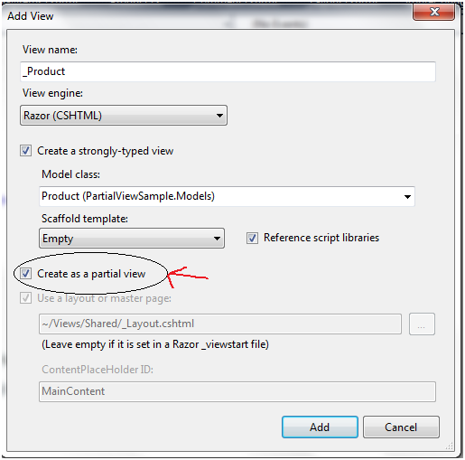
Partial Views
Enables you to define a view that will be rendered inside a parent view
Has access to the data of the parent view
Can also reuse
Partial view is like a regular view with a file extension .cshtml
To Render a Partial View
@Html.Partial("~/Views/Shared/_Product.cshtml", product);

Slide 43
Layouts
Layouts are nothing but master page in MVC
Same as a view
File Extension (.cshtml)
It is located in the Shared folder inside the Views folder.
Helpers
@RenderBody() – renders a child view
@Html.ActionLink() – to insert a HTML Link
@RenderSection - Renders the content of a named section
@Html.RenderAction - Invokes the specified child action method and renders the result inline in the parent view.
View Start
To use the layout in all the views
_ViewStart file in shared folder in views folder
@{ Layout = "~/Views/Shared/_Layout.cshtml"; }
If you remove this file, you must add this line to all views.

Slide 44
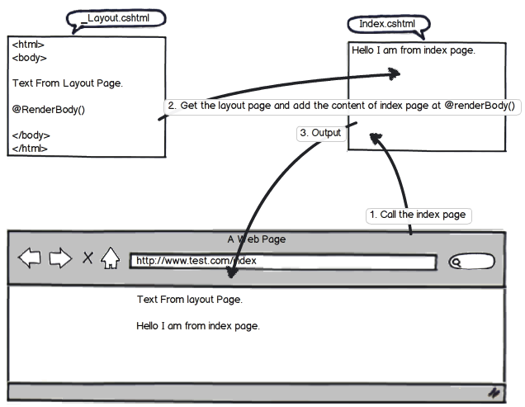
RenderBody
RenderBody method exists in the Layout page to render child page/view.
It is just like the ContentPlaceHolder in master page
A layout page can have only one RenderBody method

Slide 45
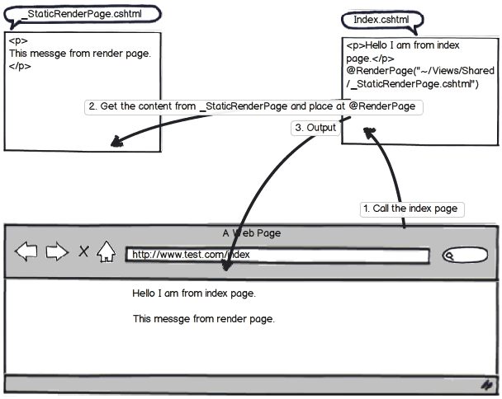
RenderPage
RenderPage method also exists in the Layout page to render other page exists in your application
A layout page can have multiple RenderPage method

Slide 46
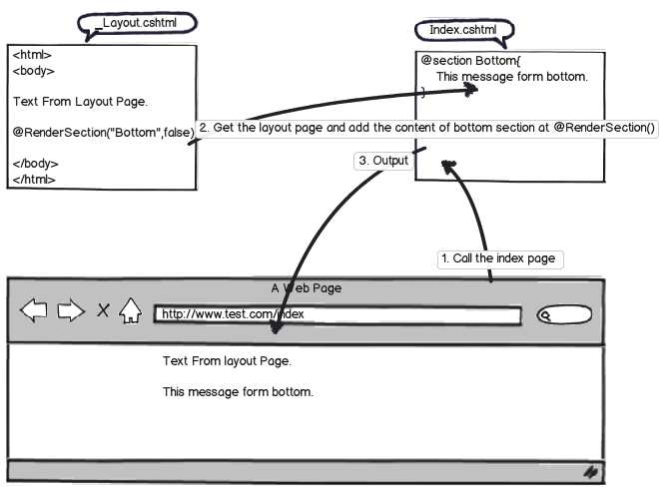
RenderSection
A section allow you to specify a region of content within a layout
It expects one parameter which is the name of the section.
RenderSection renders the content of a named section
To make sections optional, just provides the second parameter value as false

Slide 47
Passing Data From Controller to View
ViewData
ViewBag
TempData

Slide 48
ViewData & ViewBag
Helps to maintain data when you move from controller to view
Used to pass data from controller to corresponding view
Short life means value becomes null when redirection occurs
Their goal is to provide a way to communicate between controllers and views
Communication mechanism within the server call
ViewData is Faster than ViewBag

Slide 49
ViewData Vs ViewBag
View Data | View Bag
Dictionary of objects that is derived from ViewDataDictionary class and is accessible using strings as keys | Dynamic property that takes advantage of the new dynamic features in C# 4.0
Requires typecasting for complex data type and check for null values to avoid error | Doesn’t require typecasting for complex data type
public ActionResult Index() { ViewData["Name"] = “Sample MVC"; return View(); } | public ActionResult Index() { ViewBag.Name = “Sample MVC"; return View(); }
@ViewData["Name"] | @ViewBag.Name
Works with .net framework 3.5 and above | Works with .net framework 4.0 and above
Introduced in MVC 1.0 and available in MVC 1.0 and above | Introduced in MVC 3.0 and available in MVC 3.0 and above

Slide 50
TempData
TempData is used to pass data from the current request to the next request
It keeps the information for the time of an HTTP Request. This means only from one page to another
It helps to maintain the data when we move from one controller to another controller or from one action to another action
It requires typecasting for complex data type and checks for null values to avoid error.
It internally uses session variables

Slide 51
Passing Data from View to Controller
Traditional Approach
If you are having an input in the form with name 'txtName', then its values can be retrieved in controller like
string strName = Request["txtName"].ToString();
FormCollection
Can Post requested data by the FormCollection object
This object also has requested data as the name/value collection
[HttpPost] public ActionResult Calculate(FormCollection form) { string strName = form["txtName"].ToString(); . . . }
Through Parameters:
[HttpPost] public ActionResult Calculate(string txtName) { string strName = Convert.ToString(txtName); . . . . }
Strongly typed model binding to view
Create a strongly typed view which will bind directly the model data to the various fields of the page
[HttpPost] public ActionResult GetPersonName(Person person) { return Content(person.Name.ToString()); }

Slide 52
Model Validation
Need to use attributes from the System.ComponentModel.DataAnnotations namespace to specify validation for individual fields in the data model
Special attributes that are applied over the properties of a class
Has many built-in validation attributes like Required, Range, RegularExpression and StringLength
Provide both client and server validation checks with no additional coding
Can also create custom validation attributes
public class Party
{
[Required(ErrorMessage = "Start date is required")]
public DateTime StartDate { get; set; }
[Required(ErrorMessage = "No. of joinees is required")]
[Range(2, 10, ErrorMessage = "No. of joinees should be minimum 2 and not more than 10")]
public int NoOfJoinees { get; set; }
[StringLength(50),Required]
public object Name { get; set; }
}

Slide 53
Model Validation – Server
Required for ensuring that the received data is correct and valid
User could disable script in his browser or do something else to bypass client-side validation.
In this case server-side validation must required to protect our data from dirty input.
Explicit Model Validation
[HttpPost]
public ActionResult Index(Party party) {
if(ModelState.IsValid) {
// TO DO: save the party to database
return View("Thanks");
}
return View();
}
View
@Html.ValidationSummary()

Slide 54
Model Validation – Client
In Web.Config,
<appSettings>
<add key="ClientValidationEnabled" value="true" />
<add key="UnobtrusiveJavaScriptEnabled" value="true"/>
</appSettings>
Include the necessary javascript files in the layout page
jQuery
jQuery validation library
jQuery unobtrusive validation library (Developed by Microsoft)
View
@Html.ValidationMessageFor(model => model.Title)

Slide 55
ValidationAttribute
All the validation attributes are derived from the abstract class ValidationAttribute
Can be used to Create Custom Validation Attributes
public class FutureDateAttribute : ValidationAttribute
{
public override bool IsValid(object value)
{
return value != null && (DateTime)value > DateTime.Now;
}
}
The above code does only server side validation.

Slide 56
IClientValidatable
To enable client side validation on the custom validation attributes, implement the interface IClientValidatable
public class FutureDateValidatorAttribute : ValidationAttribute, IClientValidatable
{
public override bool IsValid(object value)
{
return value != null && (DateTime)value > DateTime.Now;
}
public IEnumerable<ModelClientValidationRule> GetClientValidationRules(ModelMetadata metadata, ControllerContext context)
{
yield return new ModelClientValidationRule
{
ErrorMessage = ErrorMessage,
ValidationType = "futuredate"
};
}
}
And we need to create jQuery validator and adaptor (Refer next Page)

Slide 57
IClientValidatable Cont…
jQuery.validator.addMethod('futuredate', function (value, element, params) {
if (!/Invalid|NaN/.test(new Date(value))) {
return new Date(value) > new Date();
}
return isNaN(value) && isNaN($(params).val()) || (parseFloat(value) > parseFloat($(params).val()));
}, '');
jQuery.validator.unobtrusive.adapters.add('futuredate', {}, function (options) {
options.rules['futuredate'] = true;
options.messages['futuredate'] = options.message;
});

Slide 58
Self validated model
Implement interface IValidatableObject in your Model
public class MyModel : IValidatableObject
{
public string Title { get; set; }
public string Description { get; set; }
public IEnumerable<ValidationResult> Validate(ValidationContext validationContext)
{
if (Title == null)
yield return new ValidationResult("*", new [] { "Title" });
if (Description == null)
yield return new ValidationResult("*", new [] { "Description" });
}
}
This is a server-side validation
It doesn't work on the client-side
You will have to submit your form to see validation errors
Used to do multiple validations

Slide 59
Exception Handling – Simple Try, Catch
Using the traditional .NET exception handling style i.e. try and catch block
Now when exception happens catch block gets executed and it redirects to the error view
public ActionResult SomeError()
{
try {}
catch(Exception ex)
{
return View("Error");
}
}
we will not be utilizing MVC exception mechanism properly and completely.

Slide 60
Exception Handling – OnException method
Override the “OnException” event of the controller and set the “Result” to the view name
This view gets invoked when error occurs in this controller
public class HomeController : Controller
{
protected override void OnException(ExceptionContext filterContext)
{
Exception ex = filterContext.Exception;
filterContext.ExceptionHandled = true;
var model = new HandleErrorInfo(filterContext.Exception, "Controller","Action");
filterContext.Result = new ViewResult() {
ViewName = "Error", ViewData = new ViewDataDictionary(model) };
}
}
We cannot reuse the error handling logic across multiple controllers

Slide 61
Exception Handling – HandleError Attribute
Step 1 : We need to first decorate the action method with “HandleError” attribute
public class HomeController : Controller
{
[HandleError()]
public ActionResult SomeError() { throw new Exception("test"); }
}
Step 2: In the “Web.config” file you need to add the “customErrors” tag and point to the “Error” view as shown in the below “Web.config” code snippet.
<system.web>
<customErrors defaultRedirect="Error.cshtml" mode="On"> </customErrors>
</system.web>

Slide 62
Exception Handling – HandleError Attribute Cont…
To Show different error views for different exception types:
public class HomeController : Controller
{
[HandleError(ExceptionType=typeof(ArithmeticException),View="Arthimetic")]
[HandleError(ExceptionType = typeof(NotImplementedException),View ="Error1")]
public ActionResult SomeError()
{
}
}
Drawback: Cannot reuse across other controllers
HandleError is an action filter and not a plain attribute
HandleError implements the IExceptionFilter interface
HandleError can be automatically applied to any method of any controller class by registering it as a global filter in global.asax

Slide 63
Exception Handling – HTTP Errors
All the previous techniques do not handle HTTP errors (404, 500, etc)
Handle HTTP Errors in Web.Config
<system.web>
<customErrors mode="On" defaultRedirect="Error1">
<error statusCode="404" redirect="~/Testing/NoPageFound"/>
</customErrors>
</system.web>

Slide 64
Global Error Handling
Override the “Application_Error” event and do a response.redirect from the global error event
If the error handling is not done at the controller level it will get propagated to “Global.asax” file
protected void Application_Error(object sender, EventArgs e)
{
Exception exception = Server.GetLastError();
Server.ClearError();
Response.Redirect("/Home/Error");
}

Slide 65
Error Handling – Best Practice
Create a Base Controller, Override OnException method
Enable Custom Erros in Error Config to handle HTTP Errors
Implement Global Error Handling

Slide 66
JavaScript & Ajax
ASP.NET AJAX enables a Web application to retrieve data from the server asynchronously and to update parts of the existing page
Improves the user experience by making the Web application more responsive.

Slide 67
AJAX GET
For String Data
public string TellMeDate()
{
return DateTime.Today.ToString();
}
$.get(url, { input: name }, function (data) {
$("#rData").html(data);
});
For JSON Data
public JsonResult CustomerList(string Id)
{
NorthwindEntities db = new NorthwindEntities();
var result = from r in db.Customers
where r.Country == Id
select new { r.ContactName, r.Address };
return Json(result, JsonRequestBehavior.AllowGet);
}
$.getJSON('/Home/CustomerList/' + $('#Country').val(), function (data) {
var items = '<table><tr><th>Name</th><th>Address</th></tr>';
$.each(data, function (i, country) {
items += "<tr><td>" + country.ContactName + "</td><td>" + country.Address + "</td></tr>";
});
items += "</table>";
$('#rData').html(items);
});

Slide 68
AJAX POST
Call Controllers Post Method to Post String data
[HttpPost]
public string SubmitSubscription(string Name, string Address)
{
if (!String.IsNullOrEmpty(Name) && !String.IsNullOrEmpty(Address))
//TODO: Save the data in database
return "Thank you " + Name + ". Record Saved.";
else
return "Please complete the form.";
}
$('#Save').click(function () {
var url = "/Home/SubmitSubscription";
var name = $("#Name").val();
var address = $("#Address").val();
$.post(url, { Name: name, Address: address }, function (data) {
$("#msg").html(data);
});
})

Slide 69
AJAX POST Cont…
Post a Modal to Controller
[HttpPost]
public string SubmitSubscription(Subscription subs)
{
if (!String.IsNullOrEmpty(subs.Name) && !String.IsNullOrEmpty(subs.Address))
//TODO: Save the data in database
return "Thank you " + subs.Name + ". Record Saved.";
else
return "Please complete the form.";
}
$('#Save').click(function () {
var form = $("#subscriptionForm");
var url = form.attr("action");
var formData = form.serialize();
$.post(url, formData, function (data) {
$("#msg").html(data);
});
})
public class Subscription
{
public string Name { get; set; }
public string Address { get; set; }
}

Slide 70

AJAX Helper
AJAX Helpers are used to create AJAX enabled elements like as Ajax enabled forms and links which performs request asynchronously.
AJAX Helpers are extension methods of AJAXHelper class which exist in System.Web.Mvcnamespace
Need to include jQuery unobtrusive validation library for this to work
@Ajax.ActionLink(linkText: "Call An Action", actionName: "Bark", ajaxOptions: new AjaxOptions { UpdateTargetId = "ajaxtarget", InsertionMode = InsertionMode.InsertAfter })
<div id="ajaxtarget"></div>
Action Method
public string Bark()
{
return "Woof!";
}

Slide 71
Inversion of Control (IOC)
IOC
Main goal is to remove dependencies of an application
Makes the system more decoupled and maintainable
IOC is a concept where the flow of application is inverted.
DI
Delegates
Events
Service Locator
Constructor Injection
Property Injection
Method Injection

Slide 72
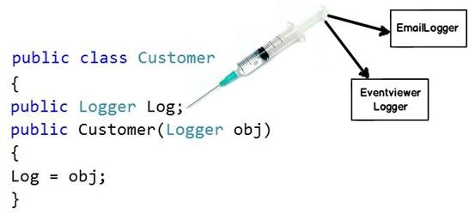
Dependency Injection
IOC is a general parent term while DI is a subset of IOC
Dependencies are injected and not created
Dependencies are injected by some external means (Ninject)
The biggest benefit achieved by DI “Decoupling”
In the sample application Ninject is used to achieve DI.
Ninject is available to download from Nuget.org
Advantages
Reduces class coupling
Increases code reusing
Improves code maintainability
Improves application testing

Slide 73
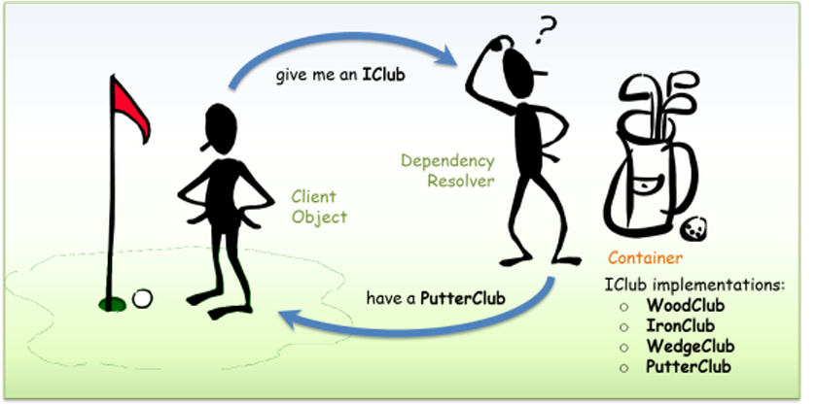
Dependency Injection

Slide 74
Popular DI Frameworks
Castle Windsor
Autofac
StructureMap
Ninject
Unity
Sprint.NET

Slide 75

NInject
Open source, lightweight Dependency Injector for .NET
Helps to split the application into a collection of loosely-coupled, highly-cohesive pieces, and then glue them back together in a flexible manner
Code will become easier to write, reuse, test, and modify
Kernel is the component that controls everything
Need to directly bind the interfaces with implementations into Kernel
How to integrate Ninject in ASP.NET MVC Application?
Add Ninject Dependencies to the project
Ninject.dll
Ninject.Web.Common.dll
Ninject.Web.Mvc.dll
Can download via Nuget

Slide 76
NInject- Cont...
Modify controller code
public class CartController : Controller {
private ICartService cartService;
public CartController(ICartService cartService) {
this.cartService = cartService;
}
In NinjectWebCommon.cs, Register/bind the dependencies
private static void RegisterServices(Ikernel kernel){
kernel.load(Assembly.GetExecutingAssembly());
kernel.bind<ICartService>().To<CartService>();
kernel.bind<IRepository<Cart>>().To<Repository<Cart>>();
GlobalConfiguration.Configuration.DependencyResolver = new NinjectResolver(kernel);
}

Slide 77
Bootstrap
Bootstrap is the most popular HTML, CSS, and JS framework for developing responsive, mobile-first projects on the web.
Bootstrap makes front-end web development faster and easier.
It's made for folks of all skill levels, devices of all shapes, and projects of all sizes.
Bootstrap is open source.
Can download from nuget

Slide 78
Bootstrap CSS
HTML5 doctype
Bootstrap makes use of certain HTML elements and CSS properties that require the use of the HTML5 doctype. Include it at the beginning of all your projects.
<!DOCTYPE html> <html lang="en"> ... </html>
Mobile first
To ensure proper rendering and touch zooming, add the viewport meta tag to your <head>.
<meta name="viewport" content="width=device-width, initial-scale=1">
You disable zooming capabilities on mobile devices by adding user-scalable=no

Slide 79
Bootstrap - Containers
Containers are used to wrap site contents and house the grid system
Use .container for a responsive fixed width container.
<div class="container">
...
</div>
Use .container-fluid for a full width container, spanning the entire width of your viewport.
<div class="container-fluid">
...
</div>

Slide 80
Bootstrap – Grid System
Grid system
Includes a responsive, mobile first fluid grid system that appropriately scales up to 12 columns as the device or viewport size increases.
Example
<div class="container-fluid">
<div class="row">
<div class="col-md-8">.col-md-8</div>
<div class="col-md-4">.col-md-4</div>
</div>
</div>
 | Extra small devicesPhones (<768px) | Small devices Tablets (≥768px) | Medium devicesDesktops (≥992px) | Large devices Desktops (≥1200px)
Class prefix | .col-xs- | .col-sm- | .col-md- | .col-lg-
# of columns | 12
Column width | Auto | ~62px | ~81px | ~97px
Gutter width | 30px (15px on each side of a column)
Nestable | Yes
Offsets | Yes
Column ordering | Yes

Slide 81

Bootstrap – Grid System
Column ordering
<div class="row">
<div class="col-md-9 col-md-push-3">.col-md-9 .col-md-push-3</div>
<div class="col-md-3 col-md-pull-9">.col-md-3 .col-md-pull-9</div>
</div>
In md and above
In sm and xs

Slide 82
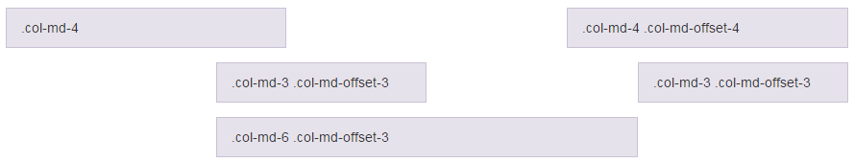
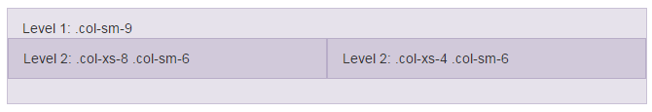
Bootstrap – Grid System
Column Offset
Column Nesting

Slide 83
Bootstrap - CSS
 | Extra small devicesPhones (<768px) | Small devicesTablets (≥768px) | Medium devicesDesktops (≥992px) | Large devicesDesktops (≥1200px)
.visible-xs-* | Visible | Hidden | Hidden | Hidden
.visible-sm-* | Hidden | Visible | Hidden | Hidden
.visible-md-* | Hidden | Hidden | Visible | Hidden
.visible-lg-* | Hidden | Hidden | Hidden | Visible
.hidden-xs | Hidden | Visible | Visible | Visible
.hidden-sm | Visible | Hidden | Visible | Visible
.hidden-md | Visible | Visible | Hidden | Visible
.hidden-lg | Visible | Visible | Visible | Hidden

Slide 84

Bootstrap - Glyphicons
Includes over 250 glyphs in font format from the Glyphicon
Free to use with bootstrap
<button type="button" class="btn btn-default btn-lg">
<span class="glyphicon glyphicon-star" aria-hidden="true"></span>
Star
</button>
For More Components: http://getbootstrap.com/components/

Slide 85
Bootstrap – Javascript Plugins
Modal Popup
Dropdown
Scrollspy
Tabs
Tooltip
Popover
Alerts
Collapse
Carousel

Slide 86
Bundling and Minification
Bundling
Too many requests from a single HTML page may cause significant delays
Bundling is therefore the process of grouping distinct resources such as CSS files into a single downloadable resource
In this way, multiple and logically distinct CSS files can be downloaded through a single HTTP request
Minification
Process that removes all unnecessary characters from a text-based resource without altering the expected functionality
Shortening identifiers
Renaming functions
Removing comments and white-space characters
Bundling requires the Microsoft ASP.NET Web Optimization Framework (Available in Nuget)

Slide 87
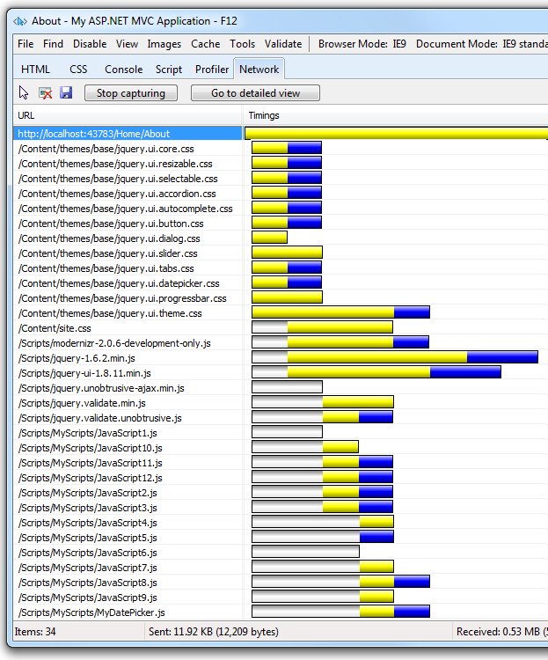
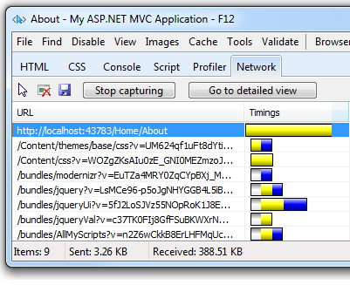
Bundling
Bundle multiple files into a single file
Fewer files means fewer HTTP requests and improve performance
Notes:
Most of the current major browsers limit the number of simultaneous connections per each hostname to six. That means that while six requests are being processed, additional requests for assets on a host will be queued by the browser. In the image below, the IE F12 developer tools network tabs shows the timing for assets required by the About view of a sample application.
http://www.asp.net/mvc/overview/performance/bundling-and-minification

Slide 88
Minification
AddAltToImg = function (imageTagAndImageID, imageContext) {
///<signature>
///<summary> Adds an alt tab to the image
// </summary>
//<param name="imgElement" type="String">The image selector.</param>
//<param name="ContextForImage" type="String">The image context.</param>
///</signature>
var imageElement = $(imageTagAndImageID, imageContext);
imageElement.attr('alt', imageElement.attr('id').replace(/ID/, ''));
}
AddAltToImg = function (n, t) { var i = $(n, t); i.attr("alt", i.attr("id").replace(/ID/, "")) }

Slide 89
Bundling and Minification - CSS
Bundles are created during the application startup in global.asax
Add BundlesConfig class to the App_Startup folder
BundleConfig class contains below method
public static void RegisterBundles( BundleCollection bundles) {
bundles.Add(new StyleBundle("~/Content/Styles")
.Include("~/Content/Styles/bootstrap.css", "~/Content/Styles/myapp.css"));
}
Can use a wildcard expression
bundles.Add(new Bundle("~/css") .Include("~/content/styles/*.css");
Use @Style to invoke a bundle
@Styles.Render("~/Content/Styles")
StyleBundle
For Bundling & Minification
Bundle
For Bundling

Slide 90
Bundling and Minification - JS
Almost same as CSS Bundling and Minification
Use Bundle to bundle Script files together
Use ScriptBundle to Bundle and Minify Script files
Need to use CDN(Content Delivery Networks) for frequently used script files (such as jQuery) for even better performance
public static void RegisterBundles(BundleCollection bundles) {
bundles.UseCdn = true; //enable CDN support
var jqueryCdnPath = "http://ajax.aspnetcdn.com/ajax/jQuery/jquery-1.7.1.min.js";
bundles.Add(new ScriptBundle("~/bundles/jquery", jqueryCdnPath)
.Include( "~/Scripts/jquery-{version}.js"));
}
Using bundle in view
@Scripts.Render("~/bundles/jquery")
Notes:
http://www.dotnetjalps.com/2014/07/cdn-in-aspnet-mvc-bundling.html
Advantages of using CDN
Content delivery networks are distributed amongst several geographic locations so it will load very fast.
There may be possibility that other application also uses same library from the same CDN and since browser caching resources based on URL and so if it used different applications that it may directly load it from browser cache.
Modern browsers limits resources downloading based on the hostnames. When you use CDN those files will be available with different hostname with different URLs and most of moderns browsers download content from different hosts in parallel and ultimately it will load much faster then normal download.
Most of CDNs are built with high capacity infrastructures so CDNs offers high availability and low latency as they are distributed in different GeoGraphic locations.
Almost all CDN provide version controls. So you can have different versions of libraries available and you can choose based on your requirement.

Slide 91
Enabling Bundling and Minification
Enabled or disabled by setting the value of the debug attribute in the compilation Element in the Web.config file.
<system.web>
<compilation debug="true" />
</system.web>
Or by enabling in Bundle Config.cs
public static void RegisterBundles(BundleCollection bundles) {
BundleTable.EnableOptimizations = true;
}
Unless EnableOptimizations is true or the debug attribute in the compilation Element in the Web.config file is set to false, files will not be bundled or minified.
And the .min version of files will not be used, the full debug versions will be selected.
EnableOptimizations overrides the debug attribute in the compilation Element in theWeb.config file

Slide 92
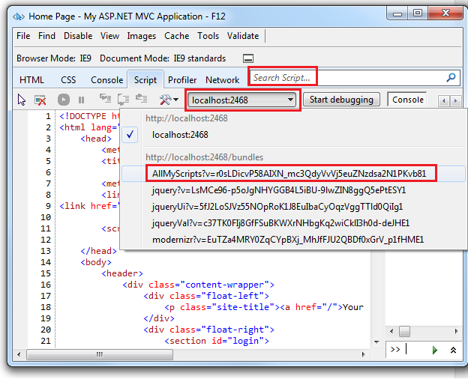
Debugging – Bundled & Minified JS
Using the IE F12 developer tools, you debug a JavaScript function included in a minified bundle using the following approach
1. Select the Script tab and then select the Start debugging button.
2. Select the bundle containing the JavaScript function you want to debug using the assets button.

Slide 93
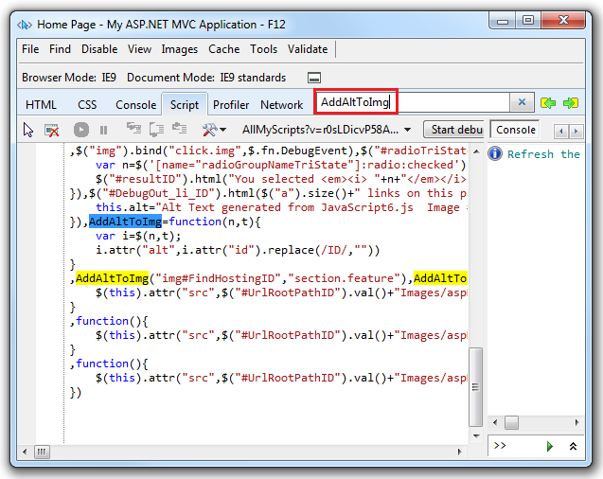
Debugging – Bundled & Minified JS Cont..
3. Format the minified JavaScript by selecting the Configuration button , and then selecting Format JavaScript.

Slide 94
Debugging – Cont..
Another option is by using Compiler Directives
To disable Minification
#if DEBUG
foreach (var bundle in BundleTable.Bundles)
{
bundle.Transforms.Clear();
}
#endif
Conditional
#if DEBUG
var jsBundle = new Bundle("~/Scripts/js");
#else
var jsBundle = new ScriptBundle("~/Scripts/js"); #endif

Slide 95
What is Filter?
Sometimes we want to perform logic either before an action method is called or after an action method is executed.
To support this ASP.NET MVC provide filters.
Filters are custom classes that provide both a declarative and programmatic means to add pre-action and post action behavior to controller action methods.

Slide 96
Filters in MVC
Authentication filters (New in ASP.NET MVC5)
Authorization filters
Action filters
Result filters
Exception filters

Slide 97
Authentication Filter
It is a process of verification that verifies “Who you are” (it confirms that you are a valid (or invalid) user)
Use the IAuthenticationFilter (System.Web.Mvc.Filters) to create a custom authentication filter
We can use authentication filters to allow users to authenticate to the application from various third-party vendors (facebook, linkedin, twitter etc…) or a custom authentication provider
IAuthenticationFilter interface provides two methods:
OnAuthentication(AuthenticationContext filterContext)
This method is used to authenticate the request & it provides the context to use for authentication.
OnAuthenticationChallenge(AuthenticationChallengeContext filterContext)
This method adds an authentication challenge to the current ActionResult & it provides the context to use for the authentication challenge.

Slide 98
Authentication Filter
public class CustomAuthenticationAttribute : ActionFilterAttribute, IAuthenticationFilter
{
public void OnAuthentication(AuthenticationContext filterContext)
{
//Logic for authenticating a user
}
//Runs after the OnAuthentication method
public void OnAuthenticationChallenge(AuthenticationChallengeContext filterContext)
{
//TODO: Additional tasks on the request
}
}

Slide 99
Authorization Filter
It is a process of verification that verifies “What to do” (It confirms you are permissible to do (or not to do) that)
public class CustomAuthorizeAttribute : AuthorizeAttribute
{
Entities context = new Entities(); // my entity
private readonly string[] allowedroles;
public CustomAuthorizeAttribute(params string[] roles)
{
this.allowedroles = roles;
}
protected override bool AuthorizeCore(HttpContextBase httpContext)
{
bool authorize = false;
foreach (var role in allowedroles)
{
var user = context.AppUser.Where(m => m.UserID == GetUser.CurrentUser/* getting user form current context */ && m.Role == role &&
m.IsActive == true); // checking active users with allowed roles.
if (user.Count() > 0)
{
authorize = true; /* return true if Entity has current user(active) with specific role */
}
}
return authorize;
}
protected override void HandleUnauthorizedRequest(AuthorizationContext filterContext)
{
filterContext.Result = new HttpUnauthorizedResult();
}
}
Authorize filter attribute implements the IAuthorizationFilter interface
[CustomAuthorize(“Administrator”,”Moderator”)
public ActionResult AddArticle()
{
return View();
}

Slide 100
Action Filter
Executed before or after an action is executed
IActionFilter interface is used to create an Action Filter which provides two methods
OnActionExecuting and OnActionExecuted which will be executed before or after an action is executed respectively

Slide 101
Result Filters
Executed before or after generating the result for an action
Result filters are called after the Action filters
IResultFilter interface is used to create an Result Filter which provides two methods
OnResultExecuting and OnResultExecuted which will be executed before or after generating the result for an action respectively

Slide 102
Exception Filters
Executed when exception occurs during the actions execution or filters execution
IExceptionFilter interface is used to create an Exception Filter which provides OnException method which will be executed when exception occurs during the actions execution or filters execution

Slide 103
Order of Filter Execution
Authentication filters
Authorization filters
Action filters
Result filters
Exception filters

Slide 104
Configuring Filters
Global level
By registering your filter into Application_Start event of Global.asax.cs file with the help of FilterConfig class
Controller level
By placing your filter on the top of the controller name
Action level
By placing your filter on the top of the action name

Slide 105
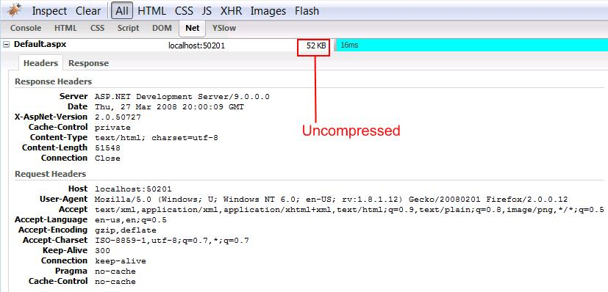
Gzip Compression
Gzip compression is used to compress the response from MVC Application
Enable Gzip compression through web server section of web config
<system.webServer>
<urlCompression doStaticCompression="true" doDynamicCompression="true" />
</system.webServer>

Slide 106
Gzip Compression
using System.Web;
using System.Web.Mvc;
public class CompressFilter : ActionFilterAttribute
{
public override void OnActionExecuting(FilterExecutingContext filterContext)
{
HttpRequestBase request = filterContext.HttpContext.Request;
string acceptEncoding = request.Headers["Accept-Encoding"];
if (string.IsNullOrEmpty(acceptEncoding))
return;
acceptEncoding = acceptEncoding.ToUpperInvariant();
HttpResponseBase response = filterContext.HttpContext.Response;
if (acceptEncoding.Contains("GZIP"))
{
response.AppendHeader("Content-encoding", "gzip");
response.Filter = new GZipStream(response.Filter, CompressionMode.Compress);
}
else if (acceptEncoding.Contains("DEFLATE"))
{
response.AppendHeader("Content-encoding", "deflate");
response.Filter = new DeflateStream(response.Filter, CompressionMode.Compress);
}
}
}
Notes:
http://weblogs.asp.net/rashid/asp-net-mvc-action-filter-caching-and-compression

Slide 107
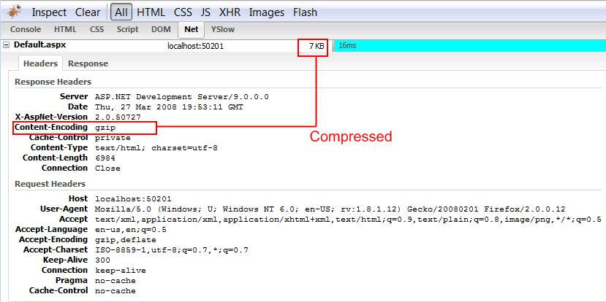
Gzip Compression
[CompressFilter]
public void Category(string name, int? page)

Slide 108
Caching
Caching plays a major role in developing highly scalable web applications.
We can cache any http get request in the user browser for a predefined time, if the user request the same URL in that predefined time the response will be loaded from the browser cache instead of the server.

Slide 109
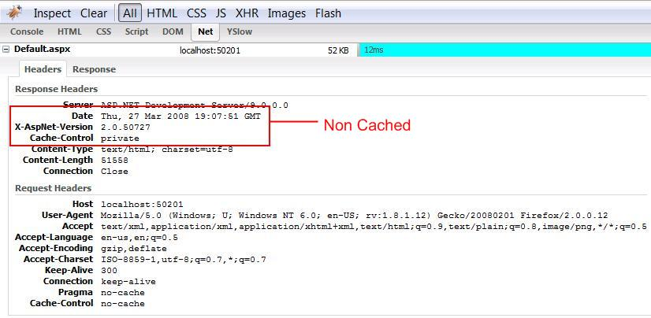
Caching

Slide 110
Caching
using System;
using System.Web;
using System.Web.Mvc;
public class CacheFilterAttribute : ActionFilterAttribute
{
/// <summary> /// Gets or sets the cache duration in seconds. The default is 10 seconds.
/// </summary> /// <value>The cache duration in seconds.</value>
public int Duration { get; set; }
public CacheFilterAttribute() { Duration = 10; }
public override void OnActionExecuted(FilterExecutedContext filterContext)
{
if (Duration <= 0)
return;
HttpCachePolicyBase cache = filterContext.HttpContext.Response.Cache;
TimeSpan cacheDuration = TimeSpan.FromSeconds(Duration);
cache.SetCacheability(HttpCacheability.Public);
cache.SetExpires(DateTime.Now.Add(cacheDuration));
cache.SetMaxAge(cacheDuration);
cache.AppendCacheExtension("must-revalidate, proxy-revalidate");
}
}

Slide 111
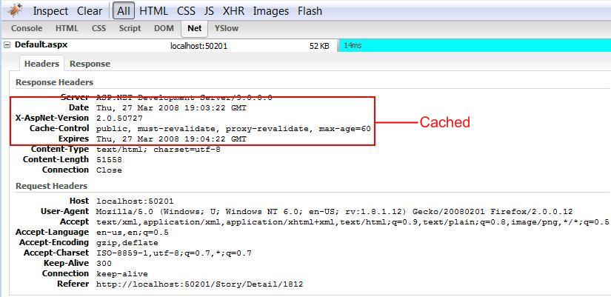
Caching
[CacheFilter(Duration = 60)]
public void Category(string name, int? page)

Slide 112
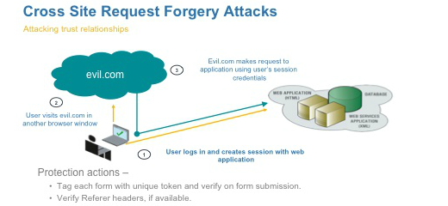
CSRF Attacks

Slide 113
CSRF Attacks Cont…
A user logs into www.example.com, using forms authentication
The server authenticates the user. The response from the server includes an authentication cookie.
Without logging out, the user visits a malicious web site. This malicious site contains the following HTML form:
<h1>You Are a Winner!</h1>
<form action="http://example.com/api/account" method="post">
<input type="hidden" name="Transaction" value="withdraw" />
<input type="hidden" name="Amount" value="1000000" />
<input type="submit" value="Click Me"/>
</form>
The user clicks the submit button. The browser includes the authentication cookie with the request
The request runs on the server with the user’s authentication context, and can do anything that an authenticated user is allowed to do.

Slide 114
CSRF Attacks Cont…
The malicious page could just as easily run a script that sends an AJAX request
Using SSL does not prevent a CSRF attack, because the malicious site can send an “https://” request
CSRF attacks are possible against web sites that use cookies for authentication, because browsers send all relevant cookies to the destination web site
Also, after a user logs in with Basic or Digest authentication. the browser automatically sends the credentials until the session ends

Slide 115
Anti-Forgery Tokens
To help prevent CSRF attacks, ASP.NET MVC uses anti-forgery tokens, also called request verification tokens
The client requests an HTML page that contains a form.
The server includes two tokens in the response. One token is sent as a cookie. The other is placed in a hidden form field. The tokens are generated randomly so that an adversary cannot guess the values.
When the client submits the form, it must send both tokens back to the server. (Browser client automatically does this when the user submits the form)
If a request does not include both tokens, the server disallows the request.
Anti-forgery tokens work because the malicious page cannot read the user’s tokens, due to same-origin policies.

Slide 116
Anti-Forgery Tokens in MVC
To add the anti-forgery tokens to a Razor page, use the HtmlHelper.AntiForgeryToken helper method:
@using (Html.BeginForm("Manage", "Account"))
{
@Html.AntiForgeryToken()
}
This method adds the hidden form field and also sets the cookie token

Slide 117
Anti-CSRF with AJAX
For AJAX requests we need to send the tokens in a custom HTTP header.
The tokens are generated at the server by calling AntiForgery.GetTokens.
<script>
@functions{
public string TokenHeaderValue()
{
string cookieToken, formToken;
AntiForgery.GetTokens(null, out cookieToken, out formToken);
return cookieToken + ":" + formToken;
}
}
$.ajax("api/values", { type: "post", contentType: "application/json", data: { }, // JSON data goes here dataType: "json", headers: { 'RequestVerificationToken': '@TokenHeaderValue()' } });
</script>

Slide 118
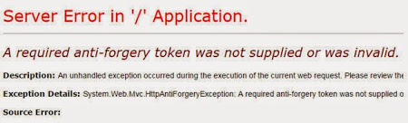
Anti-CSRF and AJAX Cont…
When you process the request, extract the tokens from the request header
Then call the AntiForgery.Validate method to validate the tokens.
The Validate method throws an exception if the tokens are not valid.
void ValidateRequestHeader(HttpRequestMessage request)
{
string cookieToken = ""; string formToken = "";
IEnumerable<string> tokenHeaders;
if (request.Headers.TryGetValues("RequestVerificationToken", out tokenHeaders))
{
string[] tokens = tokenHeaders.First().Split(':');
if (tokens.Length == 2)
{
cookieToken = tokens[0].Trim();
formToken = tokens[1].Trim();
}
}
AntiForgery.Validate(cookieToken, formToken);
}

Slide 119
Web API
Framework that makes it easy to build HTTP services that reach a broad range of clients, including browsers and mobile devices
With WebAPI content negotiation, we can return data based on the client requests
WebAPI framework deals with the request type and returns the data appropriately based on the media type
By default WebAPI provides JSON and XML based responses.
The client can make a GET, PUT, POST, and DELETE request and get the WebAPI response appropriately.

Slide 120
Selling Points (Web API)
If we need a web service and don’t need SOAP, then Asp.Net Web API is very useful
Used to build simple, non-SOAP based HTTP services on top of existing WCF message pipline
No need to configure like WCF REST services
No need for Data Contracts
Simple service creation
Light weight architecture
Focused at one thing, being easy to define and expose and consume

Slide 121
Web API - How to Choose?
Scenario | WCF | Web API
Need to support specific scenarios like Message Queues, end to end message security, distributed transactions, one way messaging etc,.. | ✓
Already you have existing working WCF services and would like to add HTTP support functionality | ✓
One code base to support SOAP and RESTful endpoints | ✓
Need to create resource oriented services over HTTP |  | ✓
Your project is MVC application and want to expose some functionality over HTTP |  | ✓
Want to build only HTTP/RESTful services |  | ✓
Duplex communication over HTTP | SignalR

Slide 122
WCF vs Web API
WCF | ASP.NET WEB API
Service | Controller
Operation | Action
Service Contract | NA
Endpoint | NA
URI Templates | ASP.NET Routing
Message Handlers | Message Handlers
Formatters | Formatters
Operation Handlers | Filters, Model Binders

Slide 123
Integrated Stack (Web API)
Modern HTTP Programming Model
Full support for ASP.NET Routing
Content Negotiation and Custom Formatters
Model Binding and Validations
Filters
Query Composition
Easy to Unit Test
Improved Inversion of Control (IoC)
Code Based Configuration
Self-Host

Slide 124
Web API - Configure Transport
Set XML or JSON based on Content-Type or Accept header
Accept: application/xml

Slide 125
Web API - Return Codes
Now have the ability to specify return codes beside 200
HttpResponseMessage
HttpStatusCode.Created 201
Response.Headers.Location = new Uri()

Slide 126
HTTP Status Codes (Top 10)
201 (CREATED) – Successful creation occurred (via either POST or PUT). Set the Location header to contain a link to the newly-created resource. Response body content may or may not be present.
204 (NO CONTENT) – Status when wrapped responses are not used and nothing is in the body (e.g. DELETE).
304 (NOT MODIFIED) – Used in response to conditional GET calls to reduce band-width usage. If used, must set the Date, Content-Location, Etag headers to what they would have been on a regular GET call. There must be no response body.
400 (BAD REQUEST) – General error when fulfilling the request would cause an invalid state. Domain validation errors, missing data, etc. are some examples.
401 (UNAUTHORIZED) – Error code for a missing or invalid authentication token.
403 (FORBIDDEN) – Error code for user not authorized to perform the operation, doesn't have rights to access the resource, or the resource is unavailable for some reason (e.g. time constraints, etc.).
404 (NOT FOUND) – Used when the requested resource is not found, whether it doesn't exist or if there was a 401 or 403 that, for security reasons, the service wants to mask.
409 (CONFLICT) – Whenever a resource conflict would be caused by fulfilling the request. Duplicate entries, deleting root objects when cascade-delete not supported are a couple of examples.
500 (INTERNAL SERVER ERROR) – The general catch-all error when the server-side throws an exception.

Slide 127
Web API - Security
[Authorize] Attribute
https over port 443
Security Tokens
Oauth (Open Authentication)

Slide 128
Web API - How to Test?
Fiddler2
Firebug (Firefox)
Chrome developer tools
Cocoa Rest Client (For MAC)
Help Page

Slide 129
Consuming Web API
Web Apps (ASP.NET, MVC, PHP, Java, ColdFusion, Ruby(Rails), Python, Pearl)
Javascript/Jquery
Mobile (iOS, Android, WP7, Blackberry OS)

Slide 130
Consuming Web API in iOS
Use NSURLConnection delegate or GCD
Show progress while waiting for response
Use JSON over XML
NSJSONSerialization class (new in iOS5)

Slide 131
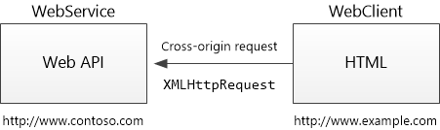
CORS – Cross Origin Resource Sharing
What is Same Origin? - If two URLs have the same origin, identical schemes, hosts, and ports.
http://example.com/foo.html
http://example.com/bar.html
What is Cross Origin?
http://example.net - Different domain
http://example.com:9000/foo.html - Different port
https://example.com/foo.html - Different scheme
http://www.example.com/foo.html - Different subdomain

Slide 132
Enable CORS
Add the CORS NuGet package
Install-Package Microsoft.AspNet.WebApi.Cors
Add the following code to the WebApiConfig.Register method in WebApiConfig.cs
config.EnableCors();
Add the [EnableCors] attribute to the Controller class
using System.Web.Http.Cors;
[EnableCors(origins: "http://mywebclient.azurewebsites.net", headers: "*", methods: "*")]
public class TestController : ApiController {
This allows cross-origin requests from WebClient, while still disallowing all other cross-domain requests.
Do not include a forward slash at the end of the origins URL.
$.support.cors = true;

Slide 133
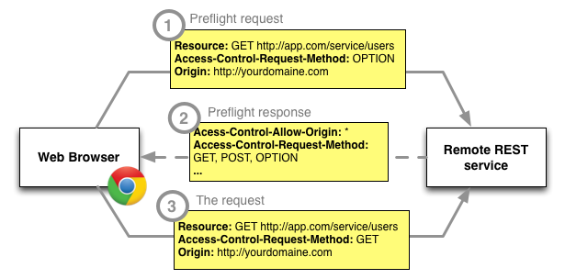
How CORS Works?

Slide 134
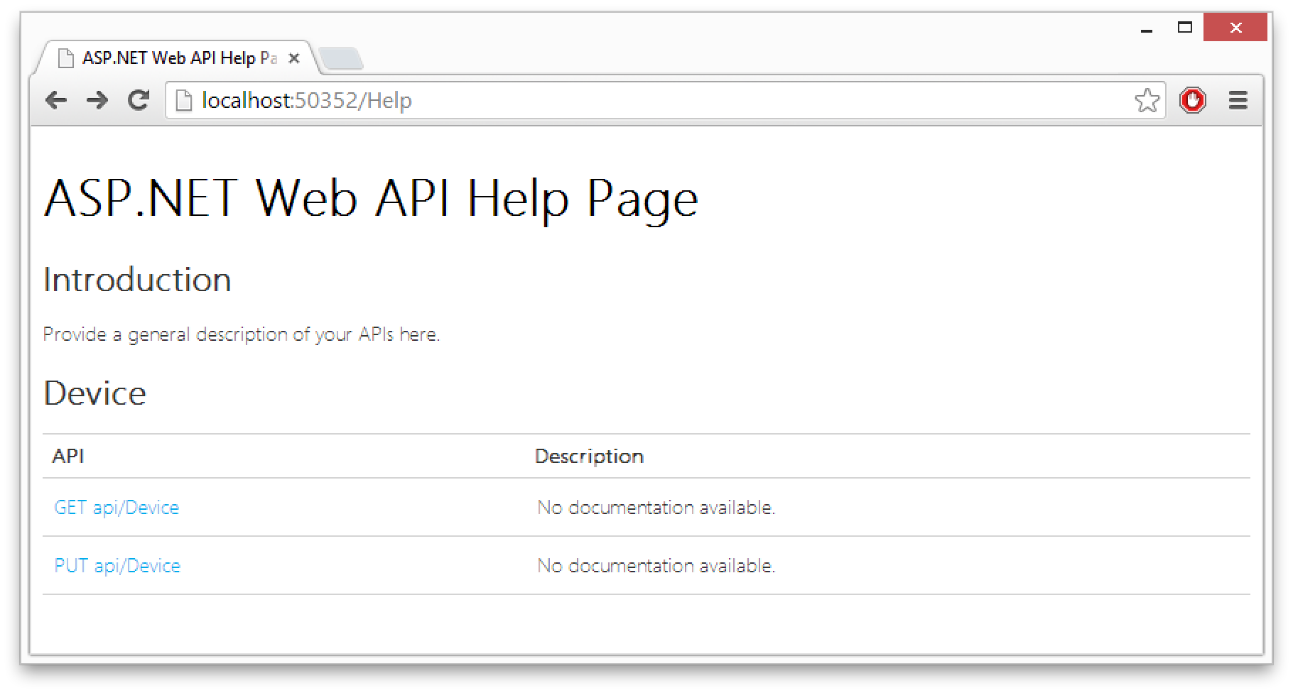
Web API – Help Page
https://www.nuget.org/packages/Microsoft.AspNet.WebApi.HelpPage/

Slide 135
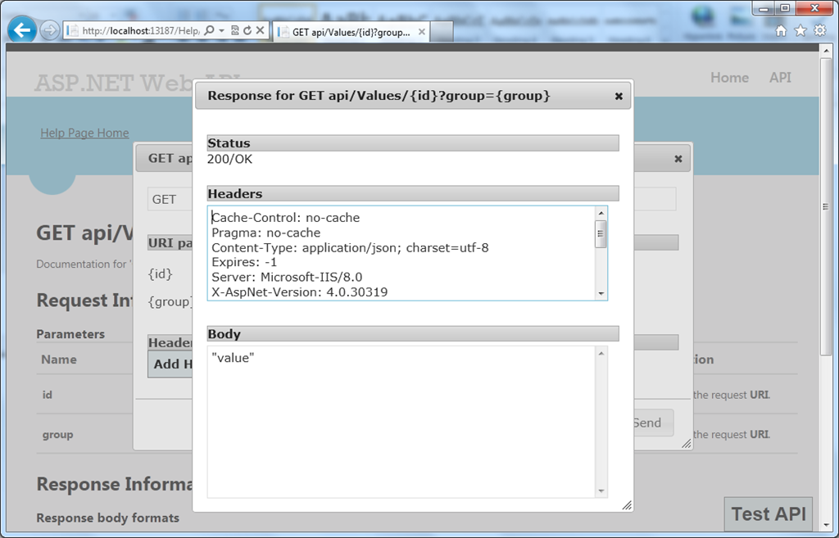
Web API – Test Client
https://www.nuget.org/packages/WebApiTestOnHelpPage/

Slide 136
Nuget
Free and open source package manager for the Microsoft development platform
NuGet client tools provide the ability to produce and consume packages.
NuGet Gallery is the central package repository used by all package authors and consumers.
https://www.nuget.org/
For Visual Studio 2010, NuGet is available through the Visual Studio Extension Manager.
Visual Studio 2012, NuGet is included in every edition by default.
To check if your copy of Visual Studio already has the NuGet extension, look for Library Package Manager in the Tools menu of Visual Studio
If your copy of Visual Studio does not already have the Library Package Manager (NuGet) extension, you can install it using the Extension Manager.

Slide 137
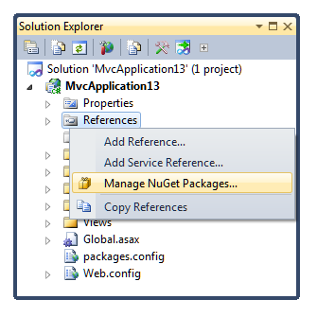
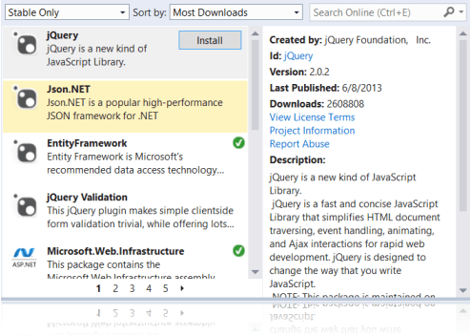
Nuget – Manage Packages

Slide 138
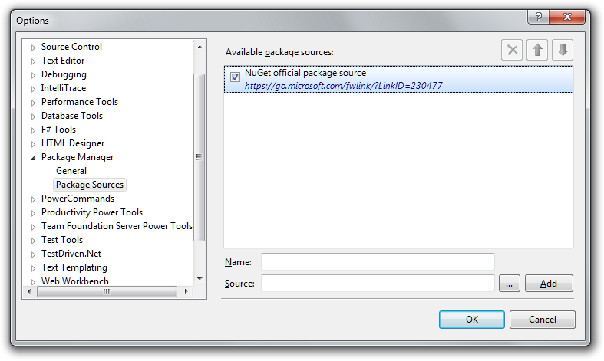
Nuget – Package Source

Slide 139
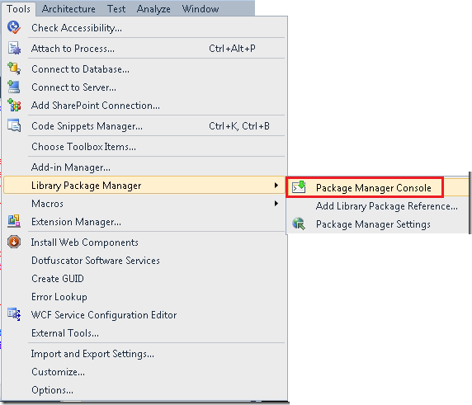
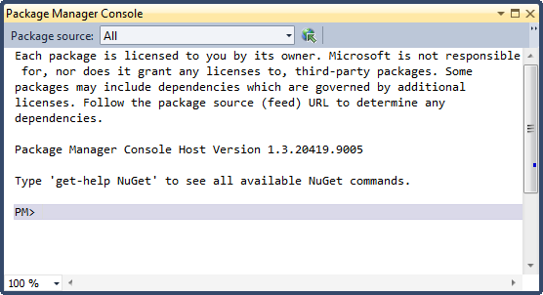
Nuget - Package Manager Console
Commands
Install-Package <Package-name>
Get-Package
List of all of the packages that are currently installed
Get-Package -ListAvailable
List of all packages that are available in the selected package source
Uninstall-Package <Package-name>
Get-Package –updates
To check if there are newer versions available for any installed packages
Update-Package <Package-name>

Slide 140
ASP.NET MVC - Best Practices
Remove unnecessary references
Bundling and Minifying CSS, JS Files
Keep Controllers Thin, No business logic in controllers
Include All validation logic in the model
No business logic in View
Put HTML in Views and Partial Views (not in a controller)
Use HTMLHelper extension methods
Authenticate and authorize users to protect content
Consider partial page updates using AJAX for reducing bandwidth
Consider using asynchronous controllers for long running requests
Implement Caching and Gzip Compression

Slide 141
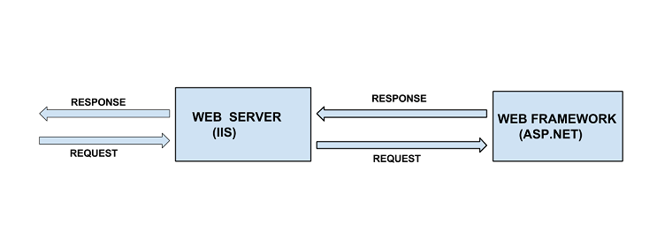
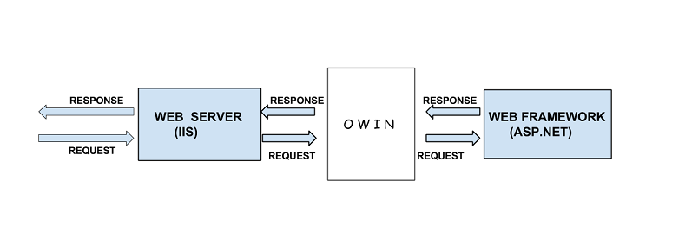
OWIN
Open Web Interface for .Net
OWIN defines a standard interface between .NET web servers and web applications. The goal of the OWIN interface is to decouple server and application

Slide 142
OWIN
OWIN decouples the web server from the application frameworks
As the web server is decoupled from the application framework we can use the application with different web servers and other components
Flexibility We have the option of selecting the different components and easily replacing one component with another one. We can mix and match different components as we see fit based on our requirement
Portable OWIN lets us connect the existing components with new components which are not restricted to any particular vendor. We can replace the host, server or the middleware anytime
Efficiency OWIN is Lightweight. OWIN provides us the capability to add and use features we require

Slide 143
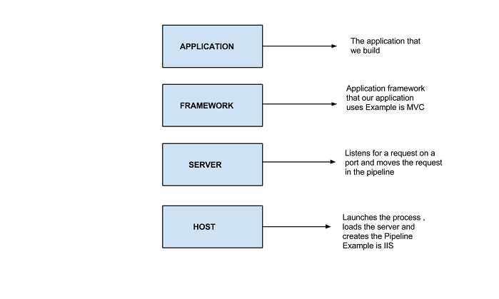
OWIN
An application built upon OWIN Specification has the following Layers

Slide 144
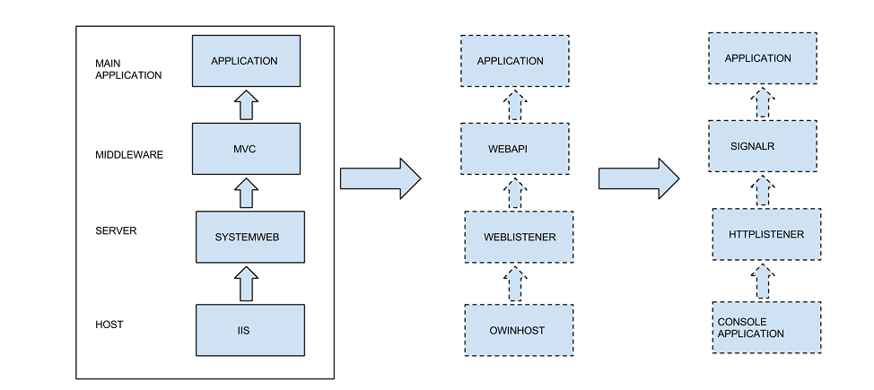
OWIN
We can swap IIS with ConsoleApplication , MVC with WebAPI , SystemWeb with WebListener without effecting our existing application. Contrast this with the traditional web development model. It gives us lot of options

Slide 145
Katana
Katana is a set of open source OWIN components built by Microsoft .It is used to build OWIN based web applications

Slide 146
ASP.NET 5 and MVC 6 Features
View Components
No More Web Forms
No More Visual Basic
ASP.NET on OSX and Linux
Tag Helpers
Unified MVC and Web API Controllers
AngularJS
ASP.NET Dependency Injection Framework
xUnit.net
Notes:
GruntJS is a task runner that enables you to build front-end resources such as JavaScript and CSS files. For example, you can use GruntJS to concatenate and minify your JavaScript files whenever you perform a build in Visual Studio

Slide 147
MVC 6
Can be run other hosts than IIS
While MVC5 can be hosted in IIS and runs on top of asp.net pipeline ,MVC 6 can be self hosted and uses flexible pipeline in which we have complete control over the components that are part of the pipeline.
Environment based configuration system
Includes new environment based configuration system, unlike depending on just the web.config file as in the previous versions.
MVC 6 applications can be very easily deployed to the cloud because of the environment based configuration system.
Supports OWIN
Notes:
http://www.codeproject.com/Articles/842923/MVC-overview

Slide 148
New file types in MVC 6
Project.json This file contains the project dependencies as well as the build information. This can also contain the commands used by the application.
Config.json This file contains the application configuration information.
Startup.cs By default the host looks for a class called Startup with a Configure method that takes IApplicationBuilder as a parameter.
Global.json defines the location for project references so that projects can reference each other.
NuGet Packages If we right click the ASP.NET reference node ,there is no option to add the assembly reference. It is because the unit of reference in MVC 6 application is nuget package and not assembly unlike the previous version.

Slide 149
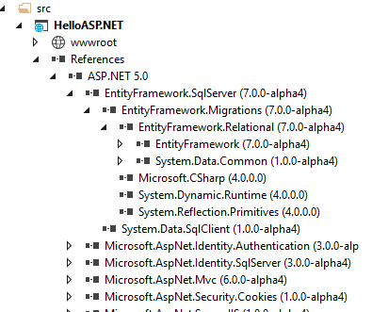
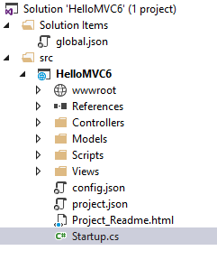
MVC 6 Solution

Slide 150
MVC 6 – View Components
1. View Components
Similar to partial views, but they are much more powerful
Include the same separation-of-concerns and testability benefits
Think of a view component as a mini-controller—it’s responsible for rendering a chunk rather than a whole response
Use view components to solve any problem that you feel is too complex with a partial, such as:
Dynamic navigation menus
Login panel
Shopping cart
Recently published articles
Sidebar content on a typical blog
https://blog.mariusschulz.com/2015/11/26/view-components-in-asp-net-mvc-6

Slide 151
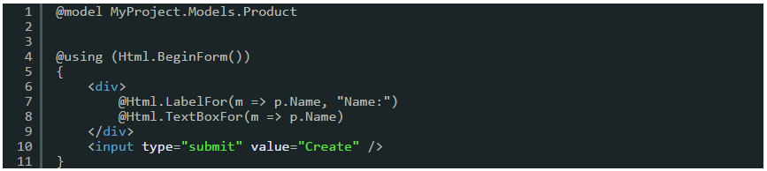
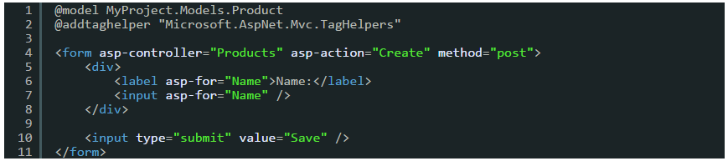
MVC 6 – Tag Helper
Tag Helpers is the one feature that might have the biggest impact on the way that you create your views in an ASP.NET MVC application.
Tag Helpers are a better alternative to using traditional MVC helpers.

Slide 152
Object Oriented JavaScript

Slide 153
Object Oriented Programming
Programming paradigm that uses abstraction to create models based on the real world
OOP uses several techniques including modularity, polymorphism, and encapsulation
OOP envisions software as a collection of cooperating objects rather than a collection of functions or simply a list of commands
Each object can receive messages, process data, and send messages to other objects
Each object can be viewed as an independent little machine with a distinct role or responsibility

Slide 154
Terminology
Namespace: A container which lets developers bundle all functionality under a unique, application-specific name.
Class: Defines the object's characteristics. A class is a template definition of an object's properties and methods
Object: An instance of a class
Property: An object characteristic, such as color
Method: An object capability, such as walk. It is a subroutine or function associated with a class

Slide 155
Terminology Cont…
Constructor: A method called at the moment an object is instantiated. It usually has the same name as the class containing it
Inheritance: A class can inherit characteristics from another class
Encapsulation: A method of bundling the data and methods that use the data
Abstraction: The conjunction of an object's complex inheritance, methods, and properties must adequately reflect a reality model
Polymorphism: Poly means "many" and morphism means "forms". Different classes might define the same method or property

Slide 156
Prototype-based Programming
Class-less programming style
It doesn't use classes, but rather it first accomplishes the behavior of any class and then reuses it by decorating existing prototype objects.

Slide 157
JavaScript Object Oriented Programming

Slide 158
Namespace
A namespace is a container which allows developers to bundle up functionality under a unique, application-specific name.
In JavaScript a namespace is just another object containing methods, properties, and objects.
The idea behind creating a namespace in JavaScript is simple: create one global object, and all variables, methods, and functions become properties of that object.
Use of namespaces also reduces the chance of name conflicts in an application

Slide 159
Namespace
// global namespace
var MYAPP = MYAPP || {};
First check whether MYAPP is already defined
If defined use the existing object, else create and empty object
// sub namespace
MYAPP.event = {};
We can also create sub-namespaces

Slide 160
Namespace
// Create container called MYAPP.commonMethod for common method and properties
MYAPP.commonMethod = {
regExForName: "", // define regex for name validation
regExForPhone: "", // define regex for phone no validation
validateName: function(name){
// Do something with name, you can access regExForName variable
// using "this.regExForName“
},
validatePhoneNo: function(phoneNo){
// do something with phone number
}
}

Slide 161
Class
JavaScript is a prototype-based language and contains no class statement
Instead, JavaScript uses functions as constructors for classes
Defining a class is as easy as defining a function
var Person = function () {};

Slide 162
Object (Class Instance)
To create a new instance of an object use the statement new
And assign the result to a variable to access it later
var person1 = new Person();
var person2 = new Person();

Slide 163
Constructor
Is called at the moment of instantiation
Is a method of the class
In JavaScript the function serves as the constructor of the object, therefore there is no need to explicitly define a constructor method
Every action declared in the class gets executed at the time of instantiation
var Person = function () {
console.log('instance created');
};
var person1 = new Person();
var person2 = new Person();

Slide 164
Property (Object Attribute)
Properties are variables contained in the class
Every instance of the object has those properties
Properties are set in the constructor (function) of the class so that they are created on each instance
The keyword this, which refers to the current object, lets you work with properties from within the class
Accessing a property outside of the class is done with the syntax: InstanceName.Property

Slide 165
Property Example
var Person = function (firstName) {
this.firstName = firstName;
console.log('Person instantiated');
};
var person1 = new Person('Alice');
var person2 = new Person('Bob');
// Show the firstName properties of the objects
console.log('person1 is ' + person1.firstName);
// logs "person1 is Alice"
console.log('person2 is ' + person2.firstName);
// logs "person2 is Bob"

Slide 166
Methods
Methods are functions
Calling a method is similar to accessing a property, but you add () at the end of the method name, possibly with arguments
To define a method, assign a function to a named property of the class's prototype property
Later, you can call the method on the object by the same name as you assigned the function to.

Slide 167
Methods Example
var Person = function (firstName) {
this.firstName = firstName;
};
Person.prototype.sayHello = function() {
console.log("Hello, I'm " + this.firstName);
};
var person1 = new Person("Alice");
var person2 = new Person("Bob");
// call the Person sayHello method.
person1.sayHello();
// logs "Hello, I'm Alice"
person2.sayHello();
// logs "Hello, I'm Bob"

Slide 168
Inheritance
Is a way to create a class as a specialized version of one or more classes
JavaScript only supports single inheritance.
The specialized class is commonly called the child, and the other class is commonly called the parent.
In JavaScript you do this by assigning an instance of the parent class to the child class, and then specializing it

Slide 169
Inheritance Example
// Define the Person constructor
var Person = function(firstName) {
this.firstName = firstName;
};
// Add a couple of methods to Person.prototype
Person.prototype.walk = function(){
console.log("I am walking!");
};
Person.prototype.sayHello = function(){
console.log("Hello, I'm " + this.firstName);
};
// Define the Student constructor
function Student(firstName, subject) {
// Call the parent constructor, making sure (using Function#call)
// that "this" is set correctly during the call
Person.call(this, firstName);
// Initialize our Student-specific properties
this.subject = subject;
};

Slide 170
Inheritance Example Cont…
// Create a Student.prototype object that inherits from Person.prototype.
// Note: A common error here is to use "new Person()" to create the
// Student.prototype. That's incorrect for several reasons, not least
// that we don't have anything to give Person for the "firstName"
// argument. The correct place to call Person is above, where we call
// it from Student.
Student.prototype = Object.create(Person.prototype);
// See note below
// Set the "constructor" property to refer to Student
Student.prototype.constructor = Student;
// Replace the "sayHello" method
Student.prototype.sayHello = function(){
console.log("Hello, I'm " + this.firstName + ". I'm studying " + this.subject + ".");
}; // Add a "sayGoodBye" method
Student.prototype.sayGoodBye = function(){
console.log("Goodbye!");
};

Slide 171
Inheritance Example Cont…
// Example usage:
var student1 = new Student("Janet", "Applied Physics");
student1.sayHello();
// "Hello, I'm Janet. I'm studying Applied Physics."
student1.walk(); // "I am walking!"
student1.sayGoodBye(); // "Goodbye!"
// Check that instanceof works correctly
console.log(student1 instanceof Person); // true
console.log(student1 instanceof Student); // true

Slide 172
Questions

